Slide 1
Introduction to DBMS
CHAPTER 1

Slide 2
Introduction
Data
Facts or values used for reference or analysis.
Data itself may not have clear meaning until it is processed.
Information
Processed data which gives some meaning and which can be used for making decisions.
Database
Database is an organized collection of interrelated data.
Eg: telephone diary, dictionary, salary sheet etc.

Slide 3
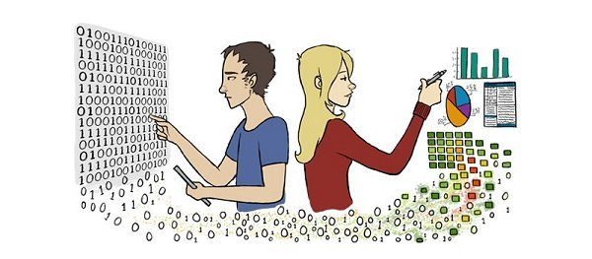
Data
Information

Slide 4
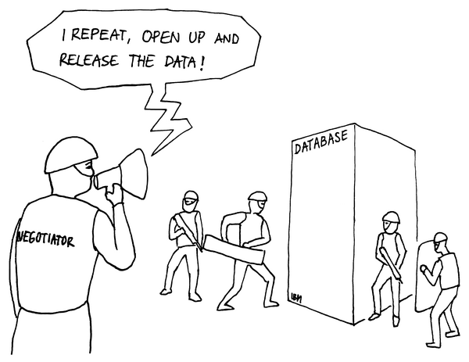

Slide 5
Database Management System (DBMS)
A database management system (DBMS) is a collection of programs that enables you to store, modify, and extract information from a database.
DBMS contains information about a particular enterprise
Collection of interrelated data
Set of programs to access the data
An environment that is both convenient and efficient to use
Databases can be very large.
Databases touch all aspects of our lives
MS-Access, MS-SQL Server, MYSQL Server, ORACLE, etc

Slide 6
Database Applications
Banking
For customer information, accounts, and loans, and banking transactions.
Airlines
For reservations and schedule information.
Universities
For student information, course registrations, and grades.
Credit card transactions
For purchases on credit cards and generation of monthly statements.
Finance
information about holdings, sales, and purchases of financial instruments such as stocks and bonds.
Telecommunication
keeping records of calls made, generating monthly bills, maintaining balances on prepaid calling cards, and storing information about the communication networks.
Manufacturing
For management of supply chain and for tracking production of items in factories, inventories of items in warehouses/stores, and orders for items.
Human resources
information about employees, salaries, payroll taxes and benefits, and for generation of paychecks.

Slide 7
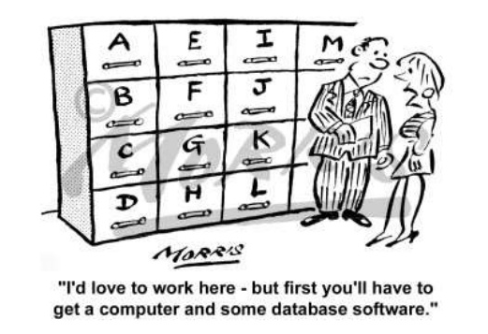

Slide 8
Database Systems versus File Systems
Data redundancy and inconsistency
Multiple file formats, duplication of information in different files
Difficulty in accessing data
Need to write a new program to carry out each new task
Data isolation —
multiple files and formats
Integrity problems
Integrity constraints (e.g., balance> 0) become “buried” in program code rather than being stated explicitly
Atomicity of updates
Failures may leave database in an inconsistent state with partial updates carried out
Concurrent access by multiple users
Concurrent access needed for performance
Uncontrolled concurrent accesses can lead to inconsistencies
Security problems
Hard to provide user access to some, but not all, data
Database systems offer solutions to all the above problems

Slide 9
The objective of DBMS (Database Management System)
Provide for mass storage of relevant data
Making easy access to data for the authorized user.
Providing prompt response to users requests for data.
Eliminate redundantly (Duplicate) data.
Allow multiple users to be active at one time.
Allow the growth of database system
Provide data integrity.
Protect the data from physical harm and unauthorized access.
Serving different types of users. the
Provide security with a user access privilege.
Combining interrelated data to generate a report
Provide multiple views for same data.

Slide 10
Advantage of DBMS
Improved data sharing:
end users have better access to more and better-managed data.
Improved data security:
A DBMS provides a framework for better enforcement of data privacy and security policies.
Better data integration:
It becomes much easier to see how actions in one segment of the company affect other segments.
Minimized data inconsistency:
Data inconsistency exists when different versions of the same data appear in different places.
The probability of data inconsistency is greatly reduced in a properly designed database.
Improved data access:
makes it possible to produce quick answers to ad hoc queries.
sends back an answer (called the query result set) to the application.
Improved decision making:
generate better-quality information, on which better decisions are based.
the DBMS does not guarantee data quality, it provides a framework to facilitate data quality initiatives.
Increased end-user productivity
The availability of data, combined with the tools that transform data into usable information, empowers end users to make quick, informed decisions that can make the difference between success and failure in the global economy.

Slide 11
Disadvantages of DBMS
Increased costs:
Database systems require sophisticated hardware and software and highly skilled personnel.
The cost of maintaining the hardware, software, and personnel required to operate and manage a database system can be substantial.
Training, licensing, and regulation compliance costs are often overlooked when database systems are implemented.
Management complexity:
Database systems interface with many different technologies and have a significant impact on a company’s resources and culture.
Given the fact that database systems hold crucial company data that are accessed from multiple sources, security issues must be assessed constantly.
Maintaining currency:
To maximize the efficiency of the database system, you must keep your system current.
must perform frequent updates and apply the latest patches and security measures to all components.
database technology advances rapidly, personnel training costs tend to be significant. Vendor dependence.
Frequent upgrade/replacement cycles:
DBMS vendors frequently upgrade their products by adding new functionality. Such new features often come bundled in new upgrade versions of the software.
Some of these versions require hardware upgrades. Not only do the upgrades themselves cost money, but it also costs money to train database users and administrators to properly use and manage the new features.

Slide 12
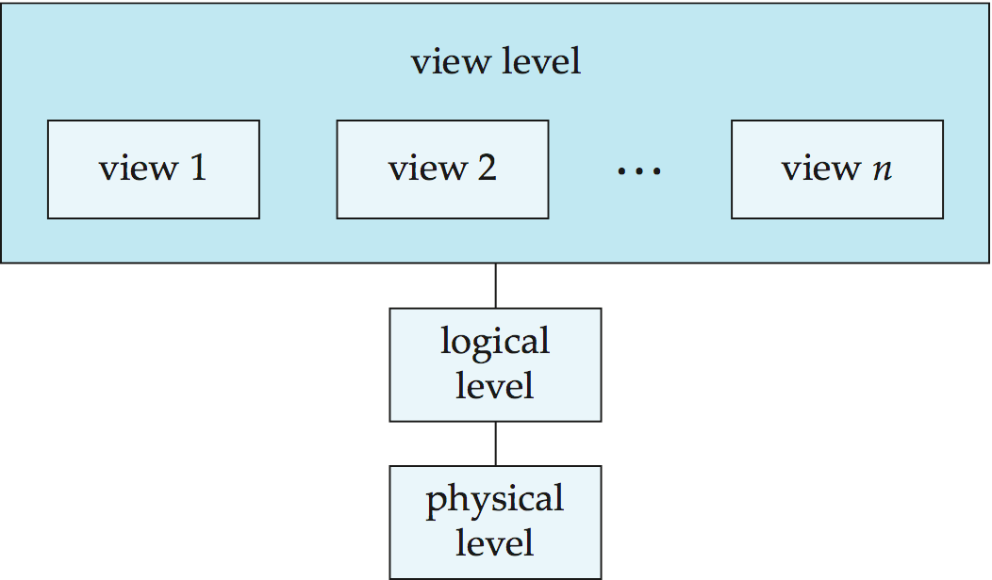
View of Data
An architecture for a database system
Notes:
12

Slide 13
Levels of Abstraction
Physical level:
The lowest level of data abstraction which describes how the data are actually stored in the storage device.
Logical level:
The logical level describes what data to be stored in the database.
It also explains about the relationships that exist among those data.
- Database administrators who decides what data must be stored in database uses the logical level of abstraction.
Notes:
13

Slide 14
Levels of Abstraction (Cont…)
The users of the logical level do not need to deal with underlying hardware complexities regarding data storage, which is known as “Physical data Independence”
For example, we may describe a record as follow:
type customer = record
name : string;
street : string;
city : integer;
end;

Slide 15
Levels of Abstraction ( Cont…)
View Level:
This is the highest level of data abstraction through which common user interacts with the database.
Application programs hides details of data structure and other complexities and provide simple interface according to the necessities of individual users.
The system may provide many views for the same database.
Views can also hide information for security purposes

Slide 16
View of Data
Database contains large volume of interrelated data.
All the data and structure of database are not useful or necessary for all users.
For the efficient utilization of database, database designers need to use complex data structures to represent data in database.
But the developers hide the complexity from users through several levels of abstraction, to simplify users’ interaction with the system

Slide 17
Data Models
Defines the structure and the design of database at the physical, logical and view levels.
A collection of tools for describing
Data
Data relationships
Data semantics
Data constraints
Relational model
Entity-Relationship data model (mainly for database design)
Object-based data models (Object-oriented and Object-relational)
Semi-structured data model (XML)
Other older models:
Network model
Hierarchical model
Notes:
17

Slide 18
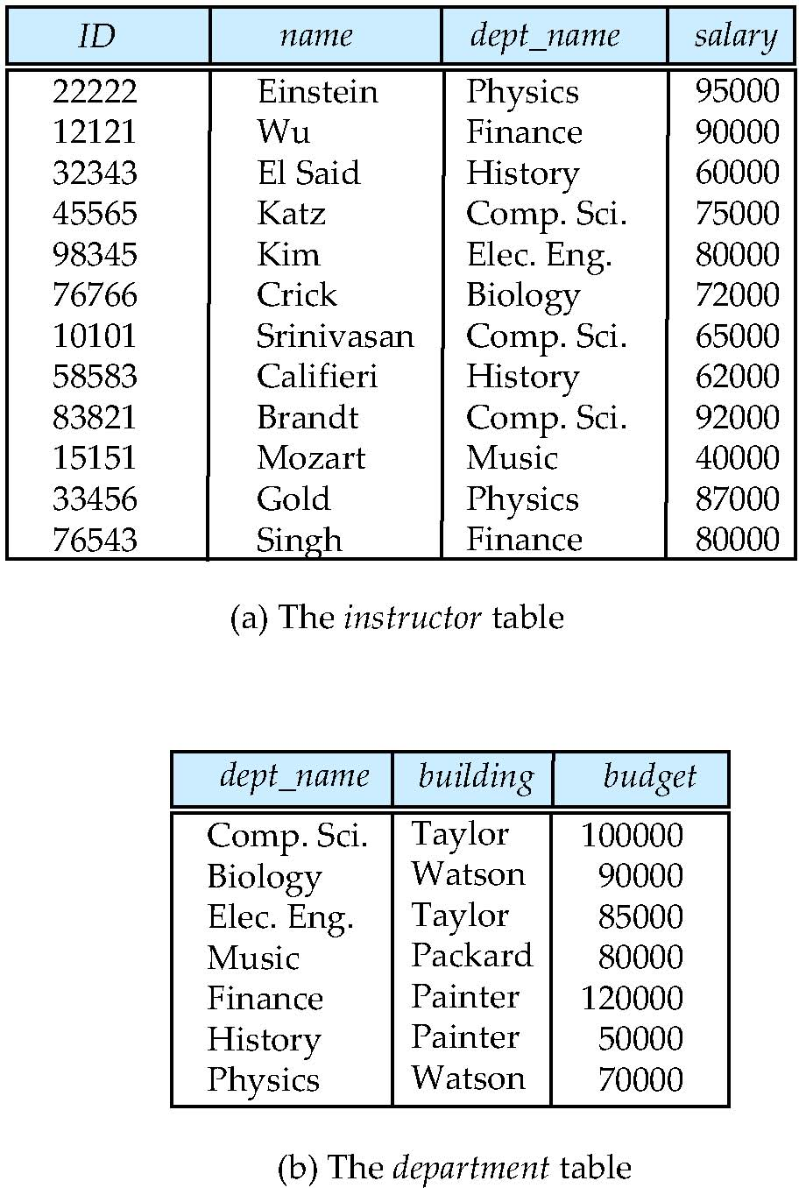
Relational Model
Most widely used data model for todays database system.
Uses collection of tables called relation to represent both data and the relationship among those data.
Each table consists of columns having unique name (called field name which represents one attribute of an object).
A row of a table contains different values for individual column to make a record, which describe an object completely.
Notes:
18

Slide 19
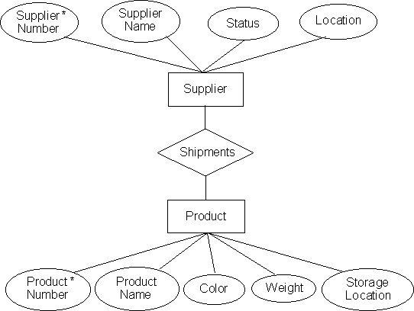
Entity-Relationship (ER) model
An entity is a “thing” or “object” which can be distinguished from any other objects in the real world.
Every entity have their own descriptive properties called as attribute, which is used as field name for table in relational database system
The E-R data model uses a collection of objects, called entities and relationships among these objects

Slide 20
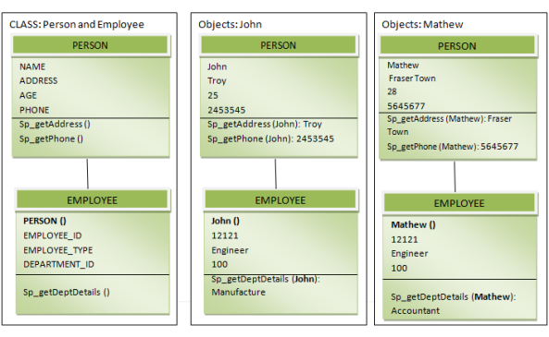
Object based data model
Object oriented technology is the latest technology in programming.
Object based data model is the extended form of E-R model with the facility of data encapsulation, data access methods (functions) etc. which gives more security to the database by combining both data and functions together inside an object.

Slide 21
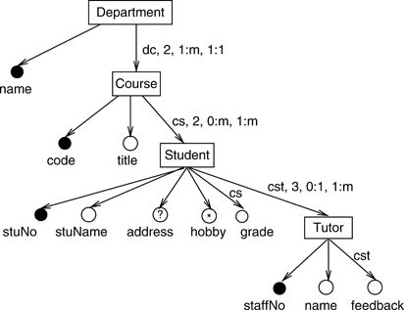
Semi-structured data model
In previous types of data models, every data item of a particular type must have the same set of attributes.
The semi-structured data model permits the specification of data where individual data items of the same type may have different sets of attributes or values.
It provides a flexible format for data exchange between different types of databases.
The XML (Extended Markup Language) and OEM(Object Exchange Model) is widely used to represent semi-structured data.

Slide 22
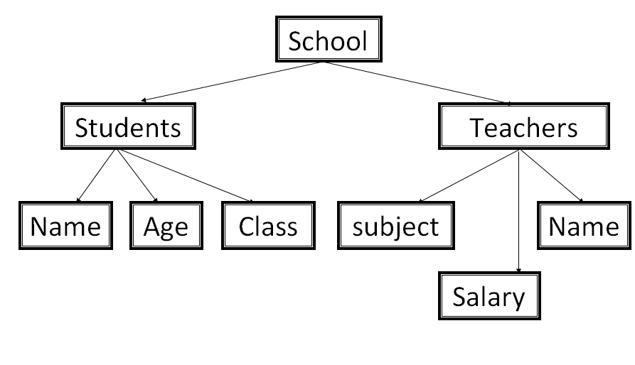
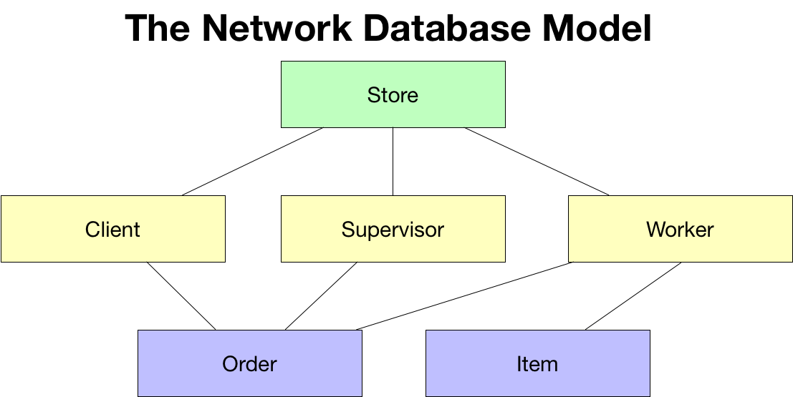
Hierarchy Data Model
Network Data Model

Slide 23
Instances and Schemas
Database instance:
Database contains collection of interrelated data and it may vary according to time as information is inserted or deleted in the database.
The collection of information stored in the database as a particular moment is called as instance of the database.
Database Schemas
The overall design of the database is called the database schema.
Once the database schema is prepared, it is not changed frequently.
Notes:
23

Slide 24
Database Languages
DDL (Data Definition Language)
Specification notation for defining the database schema
Example: create table instructor ( ID char(5), name varchar(20), dept_name varchar(20), salary numeric(8,2))
DDL compiler generates a set of table templates stored in a data dictionary
Data dictionary contains metadata (i.e., data about data)
Database schema
Integrity constraints
Primary key (ID uniquely identifies instructors)
Referential integrity (references constraint in SQL)
e.g. dept_name value in any instructor tuple must appear in department relation
Authorization

Slide 25
Database Languages
Data Manipulation Language (DML)
Language for accessing and manipulating the data organized by the appropriate data model
DML also known as query language
Two classes of languages
Procedural – user specifies what data is required and how to get those data
Declarative (nonprocedural) – user specifies what data is required without specifying how to get those data
SQL is the most widely used query language
widely used non-procedural language
Example: Find the name of the instructor with ID 22222 select name from instructor where instructor.ID = ‘22222’
Application programs generally access databases through one of
Language extensions to allow embedded SQL
Application program interface (e.g., ODBC/JDBC) which allow SQL queries to be sent to a database
Notes:
25

Slide 26
Database Languages
Query By Example (QBE)
Query by example (QBE) is a query method implemented in most database systems, most notably for relational databases.
QBE was created by Moshe Zloof at IBM in the 1970s
It is a graphical query language where users can input commands into a table like conditions and example elements.
Example Form B:
.....Name: Bob
..Address:
.....City:
....State: TX
..Zipcode:
Resulting SQL:
SELECT * FROM Contacts WHERE Name='Bob' AND State='TX';
Notes:
26

Slide 27
Database users and administrators
People who works with database can be categorized as:
Database users
Database administrators
Database users are again classified into four groups according to their nature of job.
Naïve (Simple) users
Application programmers
Sophisticated users
specialized users.

Slide 28
Database User
Naïve (Simple) users:
They are general users of database who frequently interacts with the database using database interfaces( such as forms or Web application programs).
Eg: an employee in a bank who stores records of account holders through the provided application programs or forms.
Application programmers:
They are the computer professionals with good knowledge in programming. They prepare user interfaces and other application programs through which naïve users can interact with database.
They use different tools such as Rapid Application Development (RAD)tools to prepare forms and reports with minimal effort and time.

Slide 29
Database User
Sophisticated users:
They are the higher level users with good knowledge in database and database systems.
They use database query language or data analysis software instead of using application programs to explore database.
System Analysts are the example of sophisticated users.
Specialized users:
They are the expert users who can deal with complex database systems.
They can write the specialized database applications which are used for handling very complex tasks such as Computer Aided Design(CAD), Knowledge base and Expert system etc.

Slide 30
Database Administrator (DBA)
A person who has such central control over the system is called a database administrator (DBA).
Database administrator should have good knowledge in computer, database system
he/she should be familiar about organizations structure and its information need.

Slide 31
Functions of DBA
Schema definition:
Creating a suitable database structure using DDL to store required data is the first task of DBA.
Storage structure and access method definition:
DBA should choose the type of reliable storage device to store entire content of database according to the requirement.
Schema and physical-organization modification:
DBA only has authority to modify structure and other aspects of database, if needed, to adopt varying requirements of an organization.
Granting of authorization for data access:
DBA must ensure the security and proper utilization of underlying data in database. DBA creates different users who can use database with different privileges to protect database.

Slide 32
Functions of DBA (Cont …)
Routine maintenance:
As DBMS is far reliable than traditional record keeping system, proper maintenance and security system should be implemented to run it all the time.
Periodically backing database in different storage device in different locations is the first job to preserver the data of database.
Ensuring the enough free disk space is available for normal operations, and upgrading disk space as required.
Continuous monitoring the activities performed in the database so that the performance will not go down and unauthorized access can be identified on time.

Slide 33
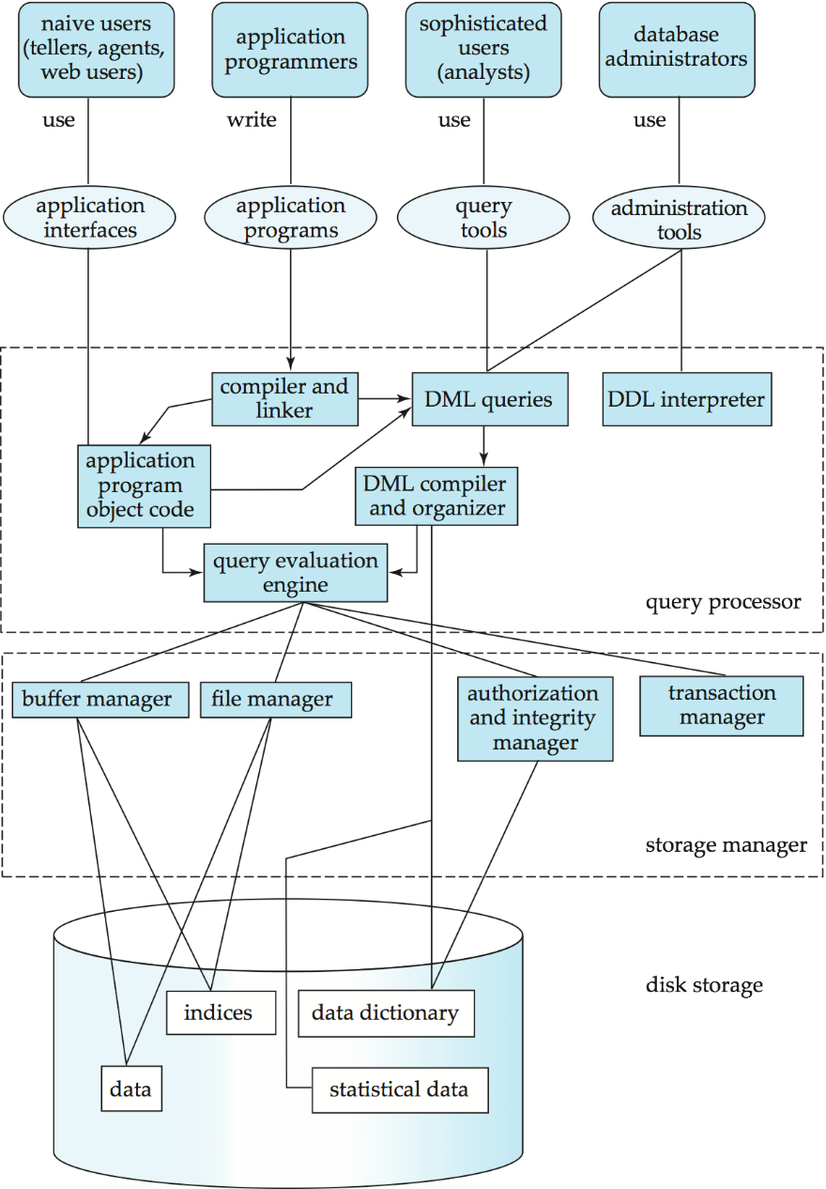
Database System Structure
Notes:
33

Slide 34
Transaction management
A transaction is a collection of operations that performs a single logical function in a database application.
While performing any transaction, it should either complete its all task or it should not perform anything at all, called as atomicity.
After any transaction, the data of database should be as reliable as it was and the correctness of data should be maintained, means consistency of database should be maintained at any cost.
What if the system fails?
What if more than one user is concurrently updating the same data?
Transaction-management component ensures that the database remains in a consistent (correct) state despite system failures (e.g., power failures and operating system crashes) and transaction failures.
Concurrency-control manager controls the interaction among the concurrent transactions, to ensure the consistency of the database.

Slide 35
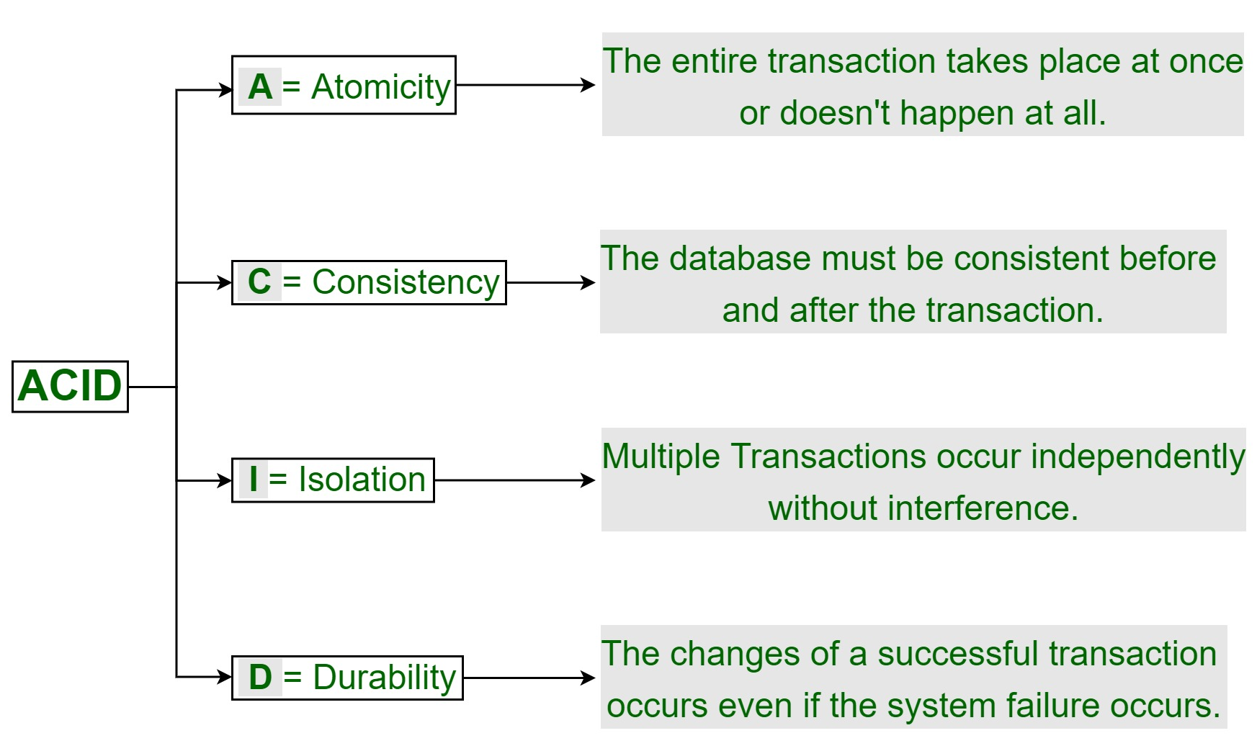
Transaction management: ACID Properties in DBMS
Notes:
35

Slide 36
Storage Management
Storage manager is a program module that provides the interface between the low-level data stored in the database and the application programs and queries submitted to the system.
The storage manager is responsible to the following tasks:
Interaction with the file manager
Efficient storing, retrieving and updating of data
Issues: Storage access, File organization, Indexing and hashing
Notes:
36

Slide 37
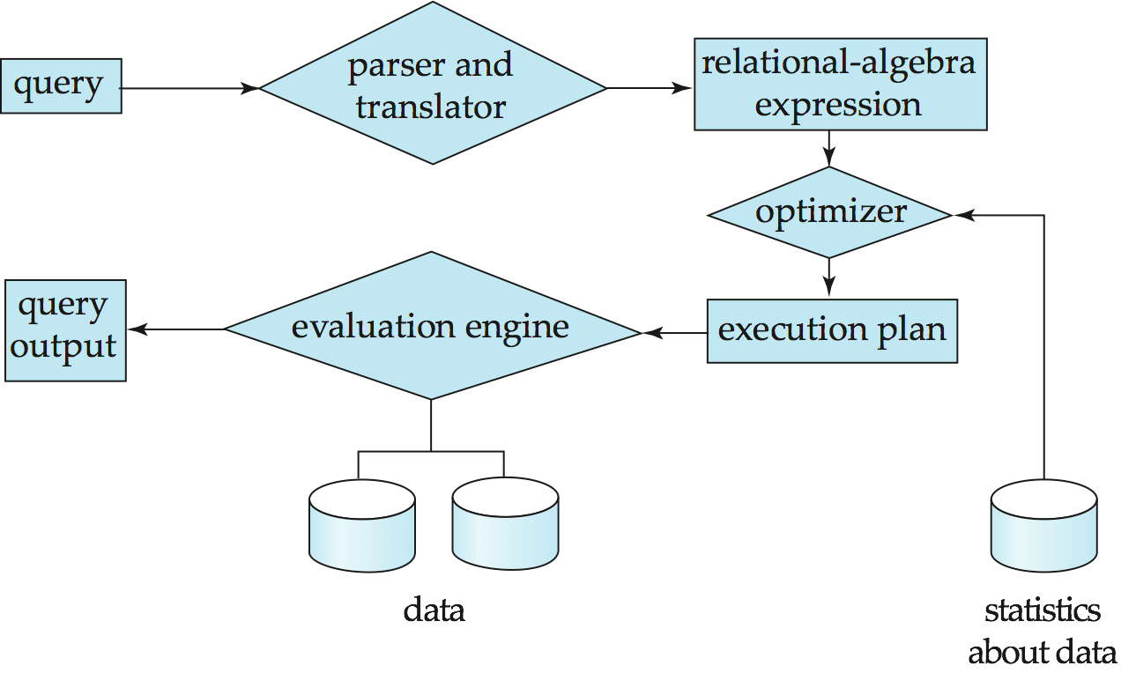
Query Processing
Notes:
37

Slide 38
Query Processing
Alternative ways of evaluating a given query
Equivalent expressions
Different algorithms for each operation
Cost difference between a good and a bad way of evaluating a query can be enormous
Need to estimate the cost of operations
Depends critically on statistical information about relations which the database must maintain
Need to estimate statistics for intermediate results to compute cost of complex expressions
Notes:
38

Slide 39
Database Architecture
The architecture of a database depends upon computer system on which the database system runs.
It may be centralized or client server where one server machine performs all tasks on behalf of multiple client machines.
It may span to geographically separated multiple computers in case of distributed database system and they need a reliable network connection to connect among those several computers.
Notes:
39

Slide 40
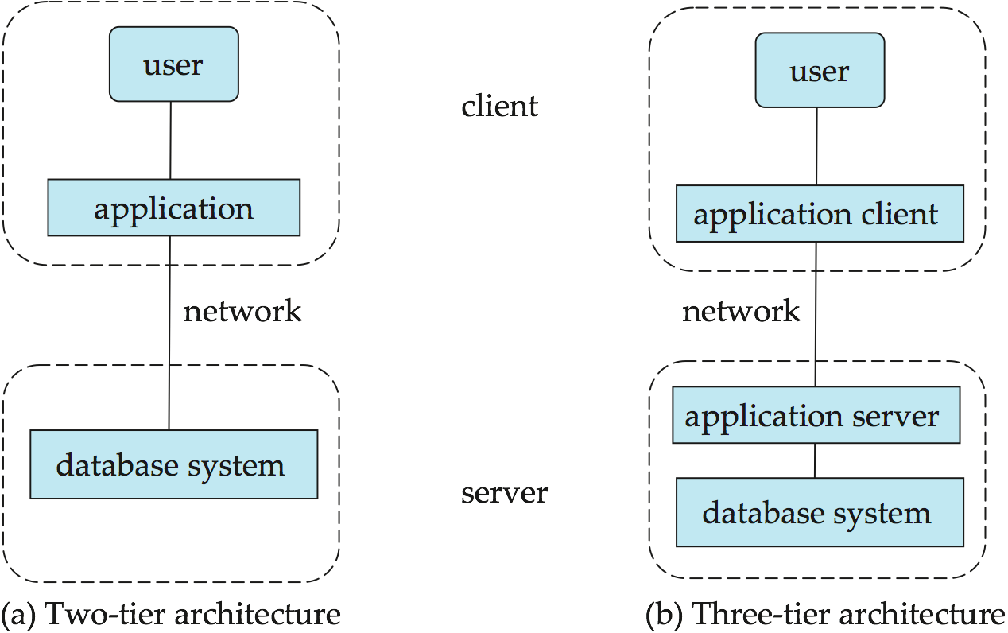
Database application architecture
Database application architecture can be categorized into two types:
Two tier architecture
Three tier architecture
Notes:
40

Slide 41
Database application architecture
Two tier architecture
In two tier architecture, the application resides on client machine, where it invokes database system functionality at the server machine through query languages.
Application program interface standards like ODBC(Open Database Connectivity) and JDBC( Java Database Connectivity) are used for interaction between the client and the server.
Three tier architecture
In three tier architecture, the client machine just act as a interface to the database and does not contain direct access to database.
The client end communicates with an application server (middleware) which consists of all business logic of database which says what actions to be taken in which condition, through a form interface.
Through application server, the users are connected to the database system.
It is more appropriate for large applications and for applications that run on the World Wide Web.

